Slide 1

NBA PLAYER STATISTICAL ANALYSIS AND PREDICTION PROJECT
COLLABORATORS:
JACOB EVANS
KARAN ANAND
MERT OZTOP
PRATIK PUROHIT
PRIYA MARINGANTI

Slide 2

OVERVIEW
This project aims to develop a basketball player statistics analysis and prediction system using machine learning techniques with NBA player datasets. The system utilizes historical player data to provide insights into player performance and predict player stats for the upcoming season, by leveraging the power of machine learning algorithms and the comprehensive NBA player statistics dataset.
Objectives
Predict basketball player stats for the upcoming season based on historical data
Leverage player stats from the previous year to forecast player performance
Identify suitable machine learning algorithms for scalability, accuracy, and interpretability in predicting player performance
Evaluate the performance of the prediction system and ensure its effectiveness in real-world scenarios, such as team selection
and player scouting

Slide 3



METHODOLOGY
Methodology
Data Collection: Gather a large dataset of NBA player statistics from the Kaggle dataset
Data Preprocessing: Clean, normalize, encode, and engineer features from the NBA dataset
Exploratory Data Analysis: Gain insights, patterns, and analyze feature distributions
Model Training and Evaluation: Experiment with various machine learning algorithms, fine-tune models for accurate predictions
User Interface Development: Create an intuitive interface for users to input player data and view predictions
Testing and Validation: Ensure the accuracy, robustness, and scalability of the prediction system
Kaggle (2022-23)
Kaggle (2021-22)
Loodibee (Team Logos)
NBA (Head Shots)

Slide 4
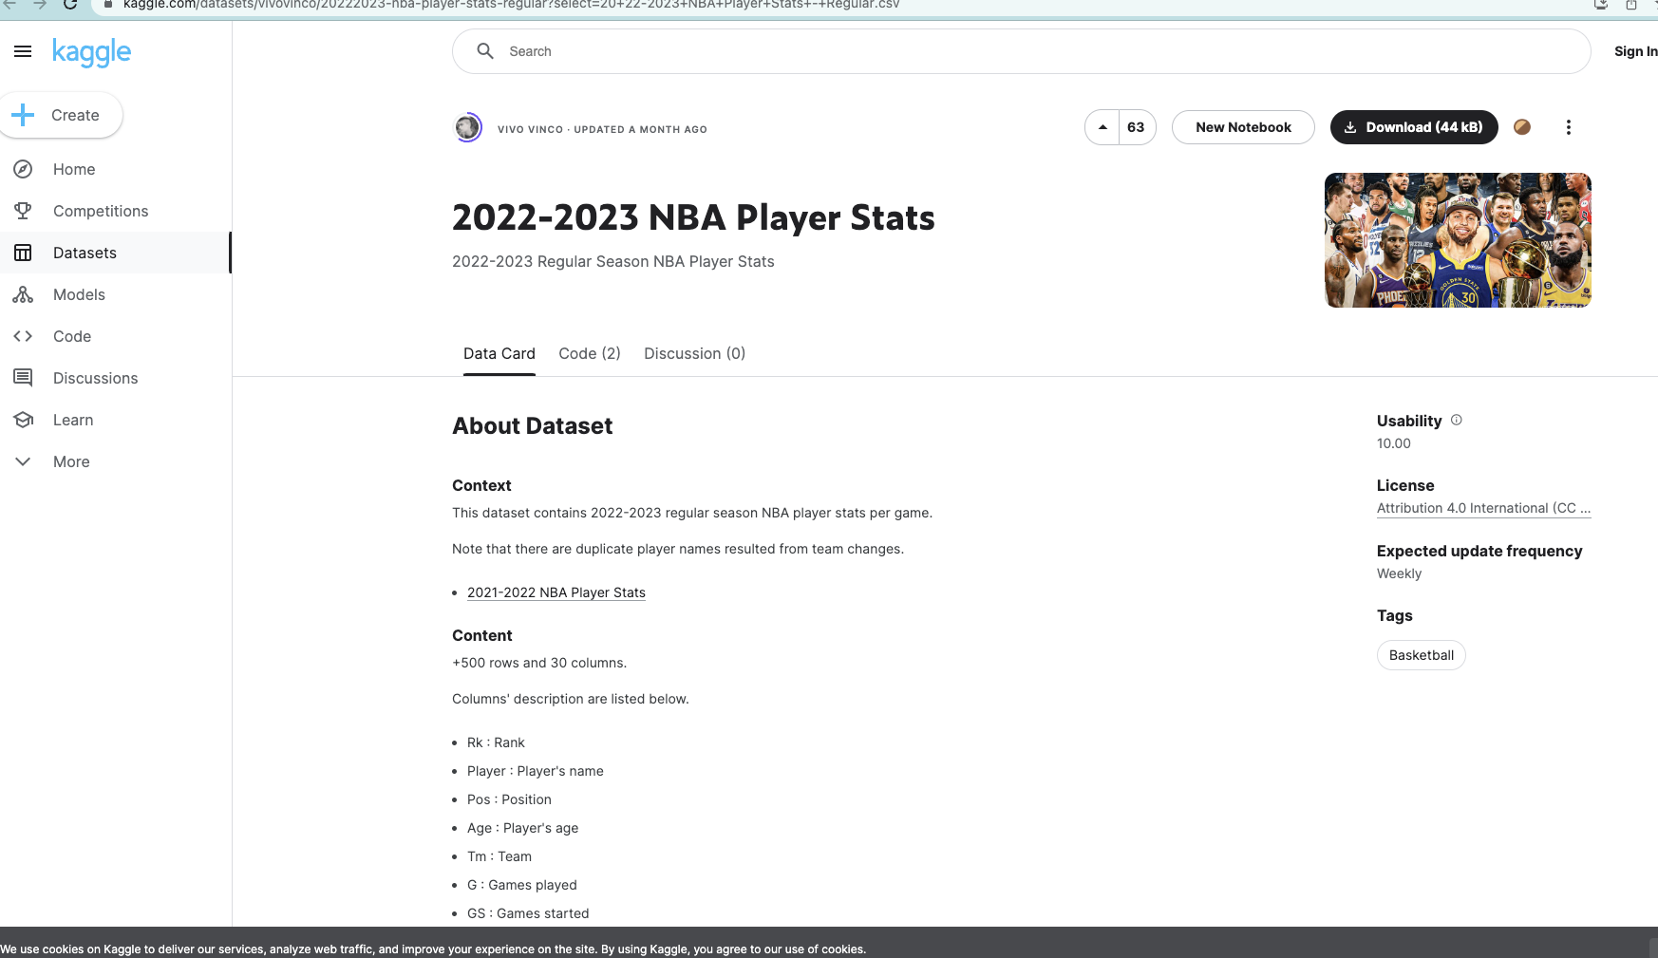
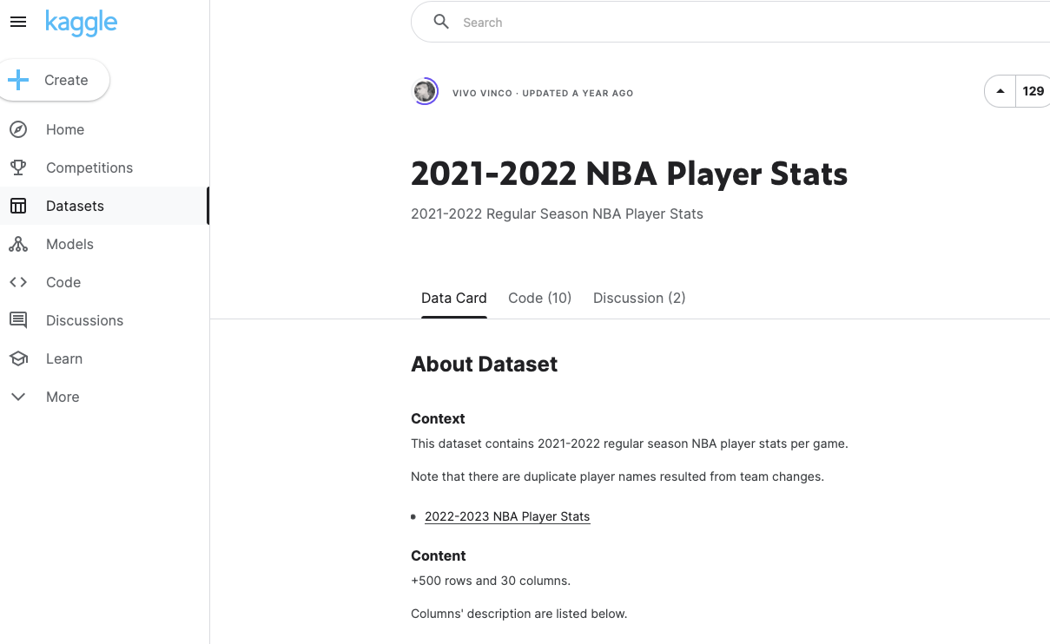
DATA SOURCE - KAGGLE
Retrieving last two seasons’ data from Kaggle

Slide 5
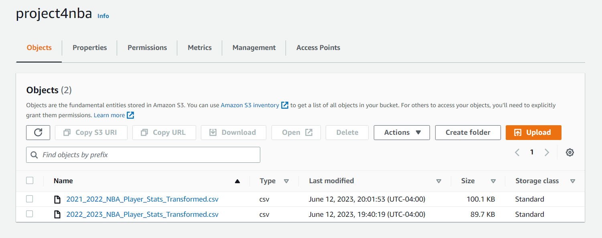
DATA ON AWS
Uploading the data sets on AWS for the main code

Slide 6
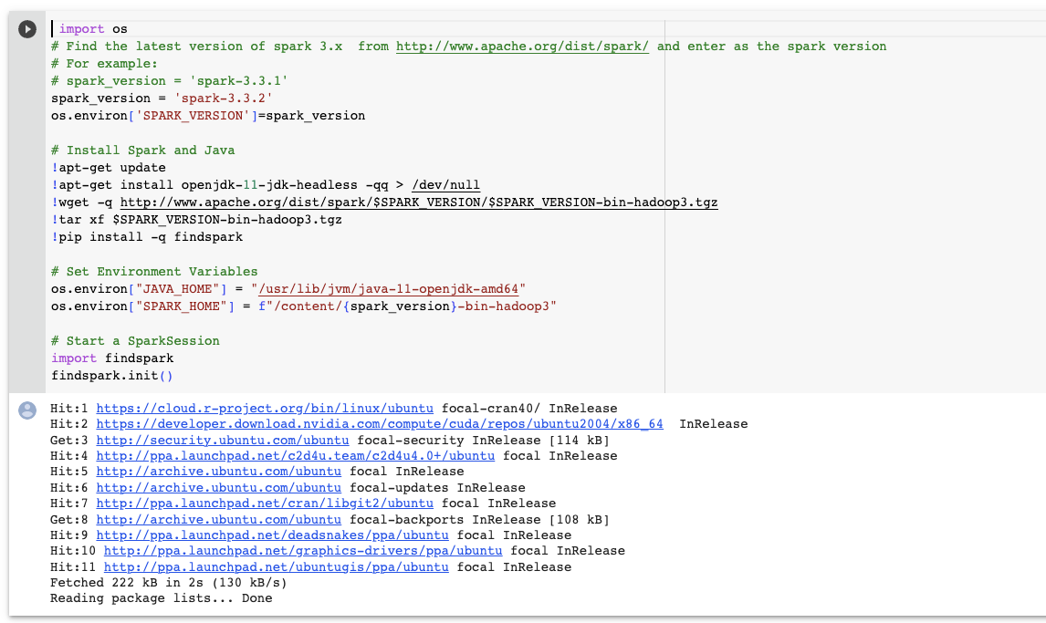
SETTING UP ENVIRONMENT
Installed the necessary tools and environment of Spark and Java

Slide 7
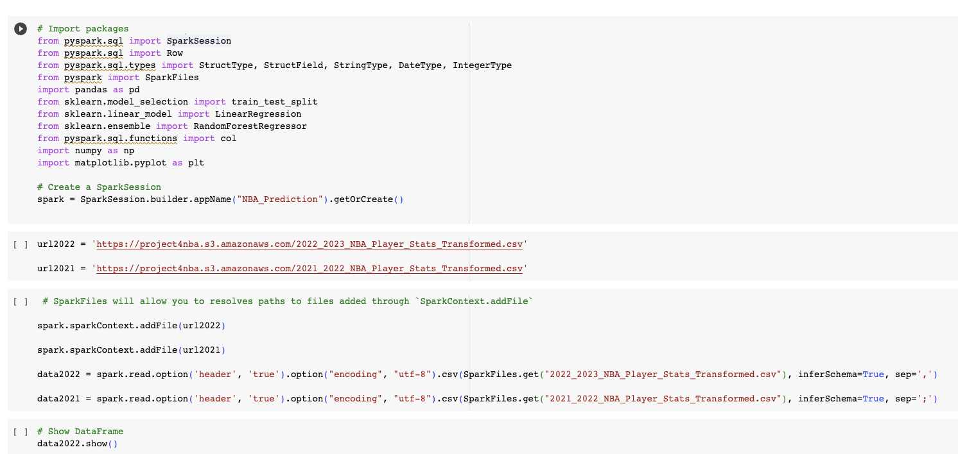
CREATING SPARK SESSION
Created a Spark Session

Slide 8
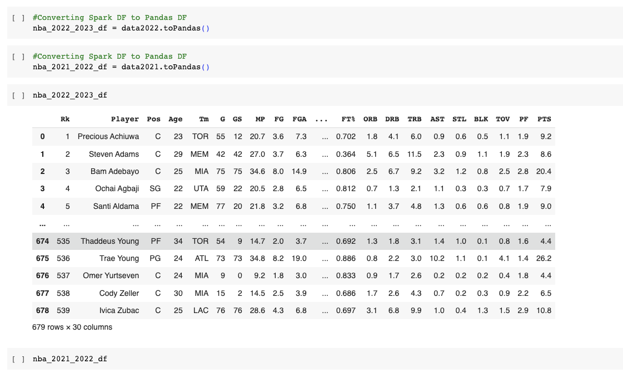
SPARK DF TO PANDA DF
Converted Spark DF to Panda DF

Slide 9
DATA CLEANING
Cleaned the data

Slide 10
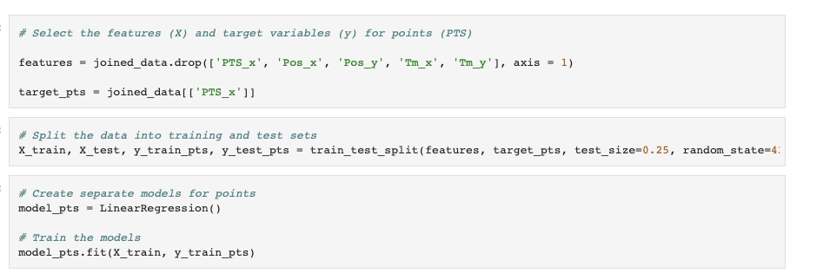
DATA MODELLING
Modeled the data

Slide 11
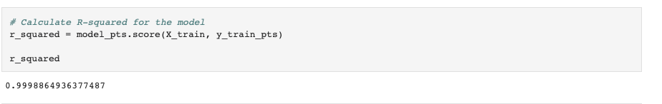
DATA ACCURACY
Calculated the R-squared for the model

Slide 12
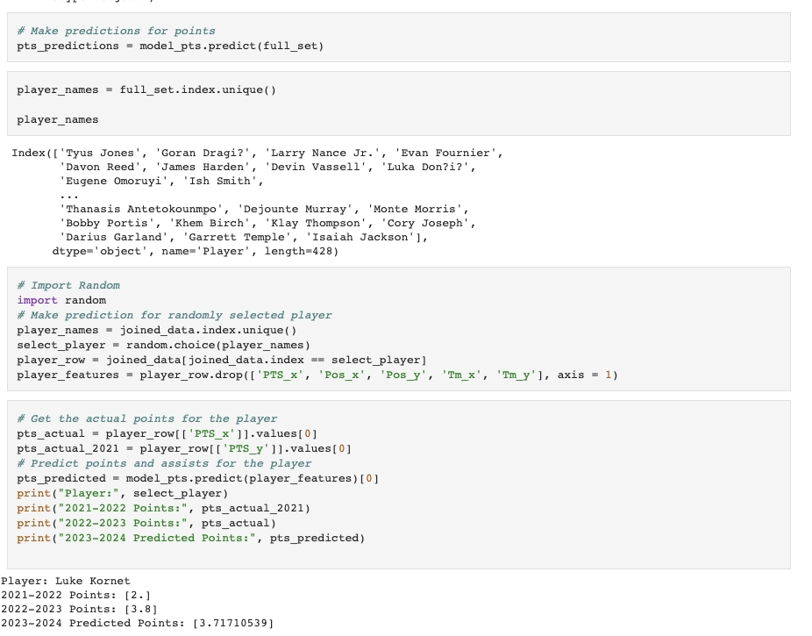
MAKING PREDICTIONS
Made predictions for the points

Slide 13
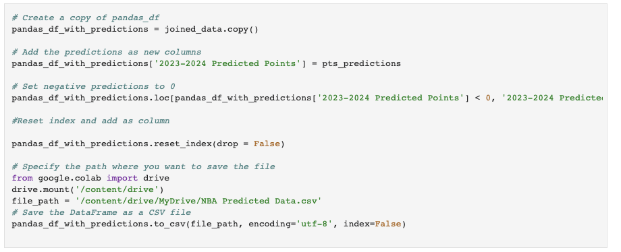
CREATING A FILE FOR TABLEAU
Downloaded the final data set for Tableau

Slide 14
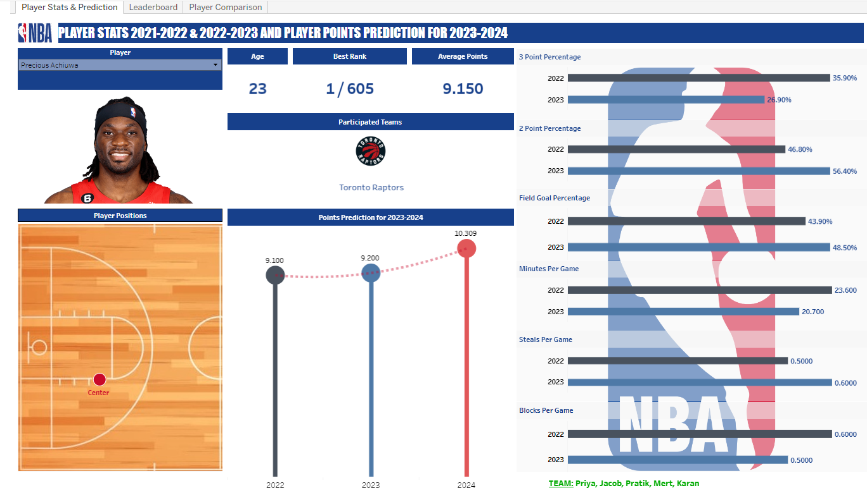
TABLEAU DASHBOARD – PLAYER STATS AND PREDICTION

Slide 15
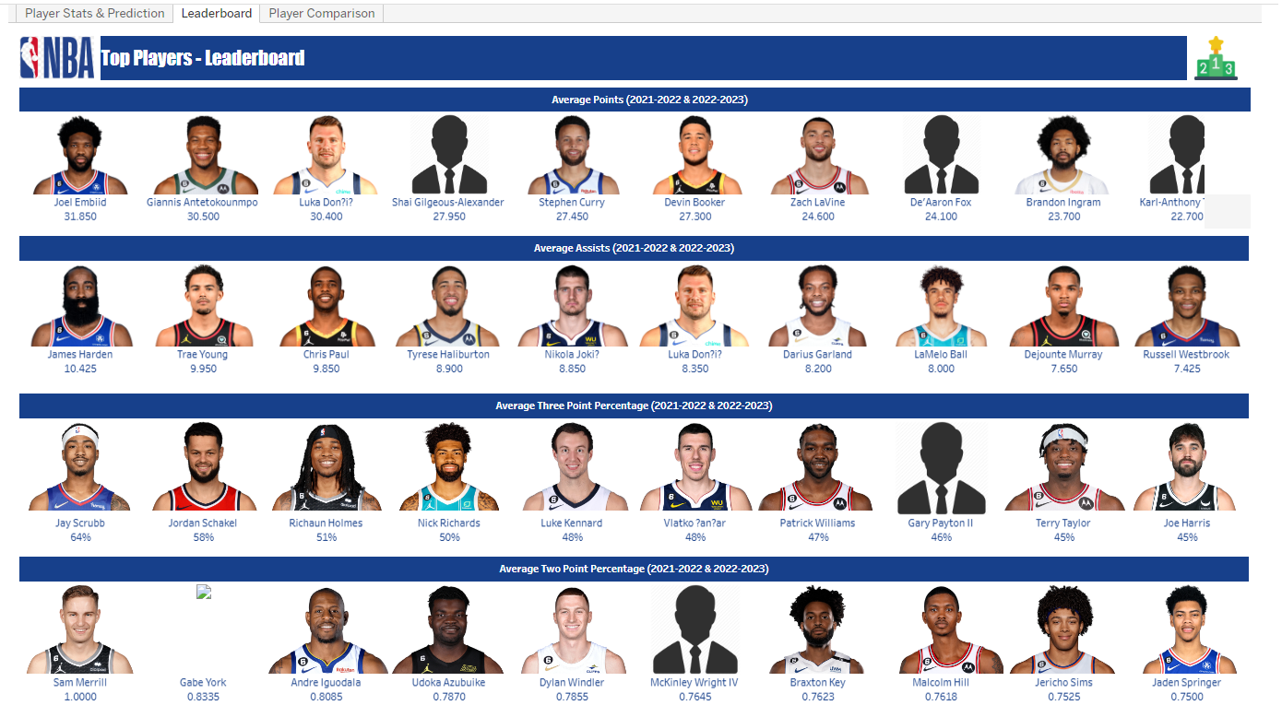
TABLEAU DASHBOARD – LEADERBOARD

Slide 16
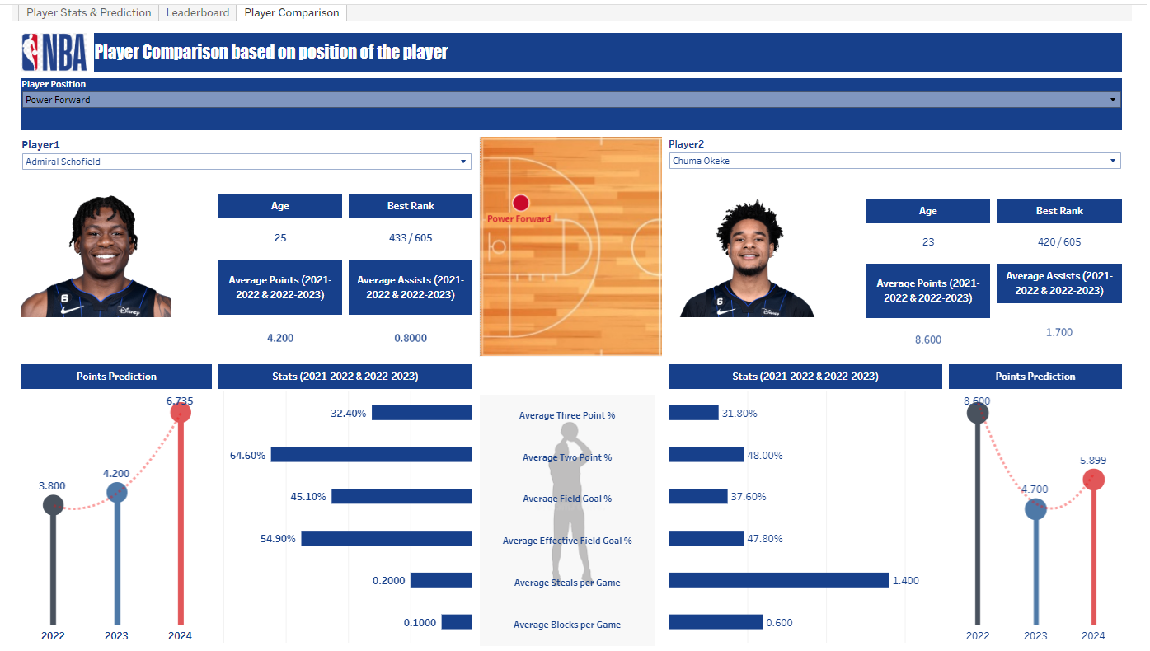
TABLEAU DASHBOARD – PLAYER COMPARISION

Slide 17
CHALLENGES
Bad Encoding: The original data had encoding issues that we struggled to handle. We had to apply encoding techniques to ensure proper handling and interpretation of the data.
External Factors: While player statistics provide valuable insights, it's important to note that other factors can influence a player's performance on the court. Factors such as injuries, team dynamics, coaching strategies, and external circumstances were not included in our analysis. Considering these external factors could further enhance the accuracy and predictive power of the model.
Outliers: To handle these outliers, we implemented a post-processing step where we replaced any negative predicted values with zeros. This approach allowed us to address the outliers and ensure that the predicted statistics remain within a valid range. By zeroing out the negative values, we mitigated the impact of outliers on the model's performance and ensured that the predicted player statistics align with the expectations of NBA player performance.

Slide 18
RESULT
The prediction system achieved R-squared value of 0.9998, indicating a high level of accuracy in predicting player statistics based on the historical data.
The NBA Player Statistics Analysis and Prediction System leverages historical player data, applies machine learning techniques, and provides valuable insights and predictions on player performance. The system can assist with team selection, player scouting, and forecasting player statistics for the upcoming season.

Slide 19
THANK YOU!
QUESTIONS ARE WELCOME!
COLLABORATORS:
JACOB EVANS
KARAN ANAND
MERT OZTOP
PRATIK PUROHIT
PRIYA MARINGANTI

